Slide 1
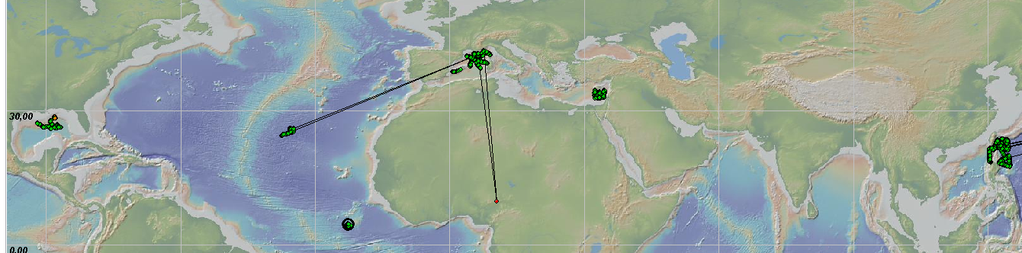
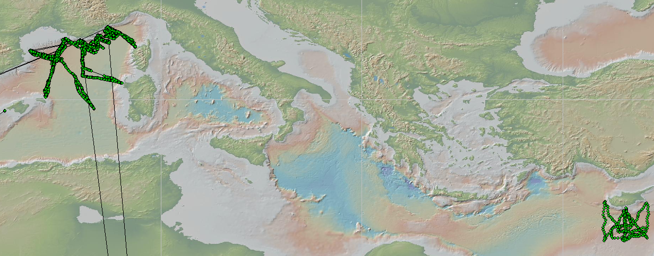
Groom gliders data management
In 2012 : 18 714 vertical profiles from 26 platforms

Slide 2
Workshop objectives
Task 1: Complete and validate the glider’s data management user’s manual
Assigned to : Thierry ?

Slide 3
Workshop objectives
Task 2 : Setup a Glider matlab data processing
  Work at DAC level
For a deployment, from raw Iridium data to the Glider NetCDF file containing:
  Metadata
  Data (times-series with profile information)
  Technical data
  Type of gliders : Slocum, seaglider, other ?
Assigned to : Justin (?), Tomeu (?), Jean-Philippe (?),
  Subtask 2.1: read Slocum data (Daniele)
  Subtask 2.2: read Seaglider data (BODC team)
  Subtask 2.3: generate the glider NetCDF file (Thierry, Lise)
  Subtask 2.4: manage metadata (Tomeu)
  Fixed metadata, transmitted metadata (navigation commands)
  Subtask 2.5: manage technical data (Mark, Daniele, Justin)

Slide 4
Workshop objectives
Task 3: Setup real-time QC and apply it on the glider NetCDF glider file
Assigned to: Tomeu, Justin

Slide 5
Workshop objectives
Task 4 : manage the non-pumped (and pumped) CTD errors or other sampling issues
Daniele

Slide 6
Workshop objectives
Task 6: oxygen data management
Convert oxygen observations (MOLAR_DOXY) to micromole/kg (DOXY) as done on Argo floats
Justin

Slide 7
Workshop objectives
Task 7: organize a collaborative development
Investigate the use of a forge such as Ifremer “Fusion forge”, subversion to distribute the matlab softwares, mantis to manage actions
  https://forge.ifremer.fr
Thierry

Slide 8
Workshop objectives
Task 8 : how to manage sea water current from the glider trajectory
When reported by the float : real-time current
When reported from a PI : delayed mode-current

Slide 9
Workshop objectives
Task 9 : specify a policy for data distribution on GTS
Mark, Justin, Thierry

Slide 10
Workshop objectives
Manage the time sampling issues from different CPUs, sensors, clock drifts
Manage duplicate times

Slide 11
Messages
from glider
*.SBD
*.DBD
EGO
decoded data
*.m
*.dat
EGO
NetCDF file
metadata
data
technical data
Decoded data
*.m
*.dat
mapping
glider variable
EGO variable
variable attributes
standard_name, unit, long_name…
deployment metadata
sensors, serial numbers…
glider metadata
name, wmo_platform_code, maker…

Slide 12
Slocum SBD data processing, a fisrt step
Read and decode SBD
  input : sbd received from the float
  manufacturer script
  result : « initial *.m *.dat »
  no metadata needed
Read and transform « initial *.m *.dat »
  Associate manufacturer variables with EGO variable names
  sci_water_temp -> TEMP, m_present_time, m_present_secs_into_mission
  Slocum-EGO metadata file
Write EGO NetCDF file
  EGO variables and data TEMP
  glider metadata file platform_code, wmo_platform_code
  glider deployment metadata file deployment, deployment_start, deployment_end
  EGO NetCDF metadata file sea_water_temperature

Slide 13
Slocum binaries real-time data processing, a first step
Step 1 : read and decode *.tbd *.sbd files from glider to (*.m, *.dat)
  The *.sbd and *.tbd files are transmistted in real-time.
    The *.sbd files contain a subset of glider technical data (nav)
    The *.tbd files contain a subset of glider scientific data (sci)
    This subset is configured by the operator in a sbdlist.dat file listing the data (engineering, scientific) to be transmitted.
    There is a minimum set of data to be transmitted under definition by Gerd working group
  The script is provided by the manufacturer
  The glider operator usually does not configurate the script to filter binary data
  The script is operated by the glider operator, not by the data centre
  The data centre archives the files received in real time

Slide 14
Slocum SBD data processing, a first step
Step 2 : read and decode initial (*.m *.dat) into NetCDF
  input : « initial *.m *.dat »
  Ego matlab script, metadata : json
    Read input data
    Rename manufacturer variables with EGO variable names
    sci_water_temp -> TEMP, sea_water_temperature, Celsius_degree…
    Add EGO attributes to variables
    Write the NetCDF file
  Output: initial EGO NetCDF data file
Step 3 : set global attributes of EGO NetCDF file from
  glider ncml metadata file platform_code, wmo_platform_code
  glider deployment ncml metadata file deployment, deployment_start, deployment_end
Step 4 : add sensor description variables

Slide 15
JSON metadata
That ends up in the EGO netcdf
Glider family variables to EGO variable names {EGO}
  Variable attribtes : CF, SDN, unit and a prefered name
EGO-NetCDF metadata {at DAC level based on latest version}
  Format version, data_type, date_update, …
Deployment metadata {glider team}
  global attributes and variables (area, launch_date, cruise_id)
Glider metadata {glider team}
  Global attributes and variables for glider description (platform_code, wmo…)
Sensor metadata (multiples by deployment?) {glider team}
  Description (sensor model, serial number…)
Calibration information(n_param,n_cal’n) (1sensor:many cal’ns 1var:many cal’ns) {technicians/glider team ?}
  Calibration date, calibration equation, calibration parameters
Translation table JSON – informs writer
EGO-NetCDF fields (optional/mandatory) {at DAC level}
Sensor model common attributes {manufacturer provides}

Slide 16
Collaborative development proposal
Subversion repository
The EGO-gliders data processing softwares and tools can be managed in a repository
svn checkout --username *** https://forge.ifremer.fr/svn/oo-ego-gliders/trunk
svn list --username *** https://forge.ifremer.fr/svn/oo-ego-gliders/trunk

Slide 17
Collaborative development proposal
Mantis for action mangement
Mantis is orginally a bugtracker. I propose to use it to manage our data management actions
https://forge.ifremer.fr/mantis/
On the top right,

Slide 18

Collaborative development proposal
Mantis for action mangement
Mantis is orginally a bugtracker. I propose to use it to manage our data management actions
https://forge.ifremer.fr/mantis/
On the top right, select “ego-gliders”
Simple workflow
  Submitted pale yellow
  Accepted orange
  Delivered green
  Closed grey
  Pending camel (à la mode cette année)

Slide 19

Collaborative development proposal
Testlink for validation
A series of tests are specified in testlink
For each new version of the EGO code, a test report is updated on Testlink

Slide 20
Glider
  Deployment 1
  Deployment 2
    Sensor 1
    Sensor 2
      Parameter 1
      Parameter 2
        Calibration 1
        Calibration 2

